Slide 1
E
N
I
A
C
DISCOUNTS
Data Analysis

Slide 2


?
DISCOUNTING
BENEFICIAL
NOT BENEFICIAL
%

Slide 3
General Insights:
96%
4%
Discounted products
Not discounted products
SOLD

Slide 4
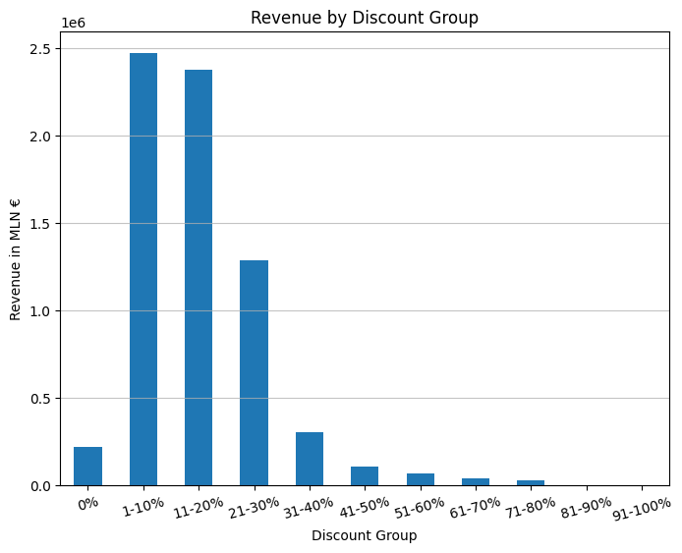
89% revenue
1-30%

Slide 5
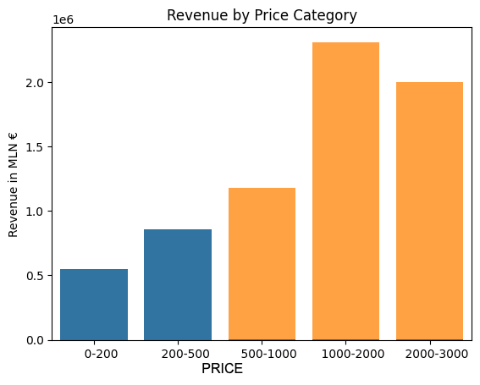
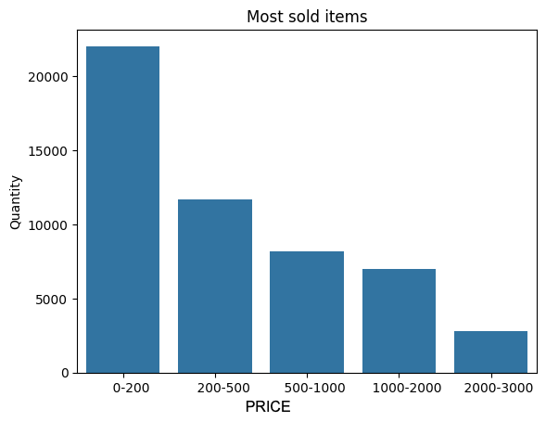
Accessories up to 500€
are being ordered in high quantities…
18 000 items
5.5 M €
34 000 items
1.4 M €
…but the ones from 500 - 3000€ are making the most money.
Let’s look how much discounted those items are.

Slide 6
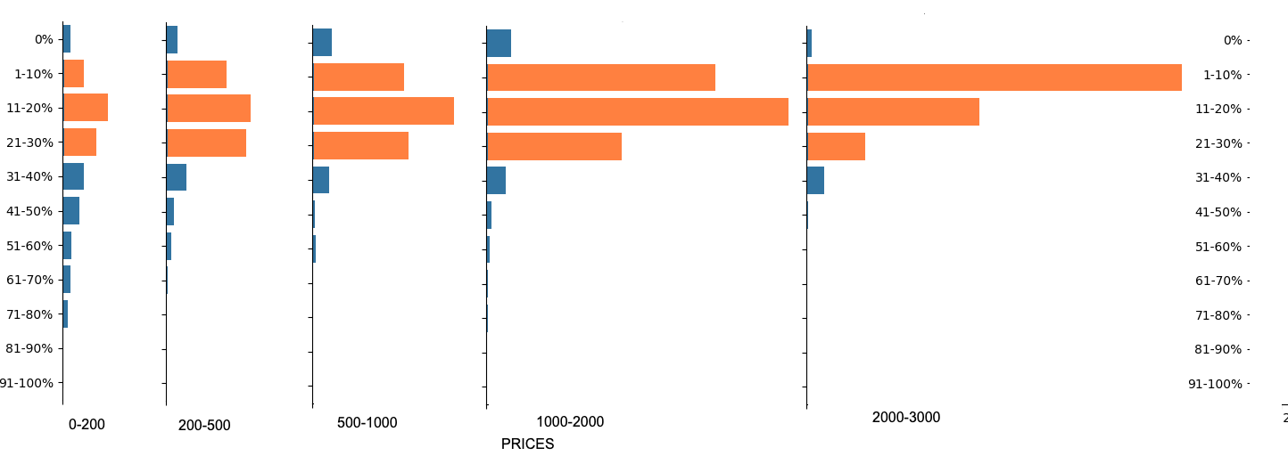
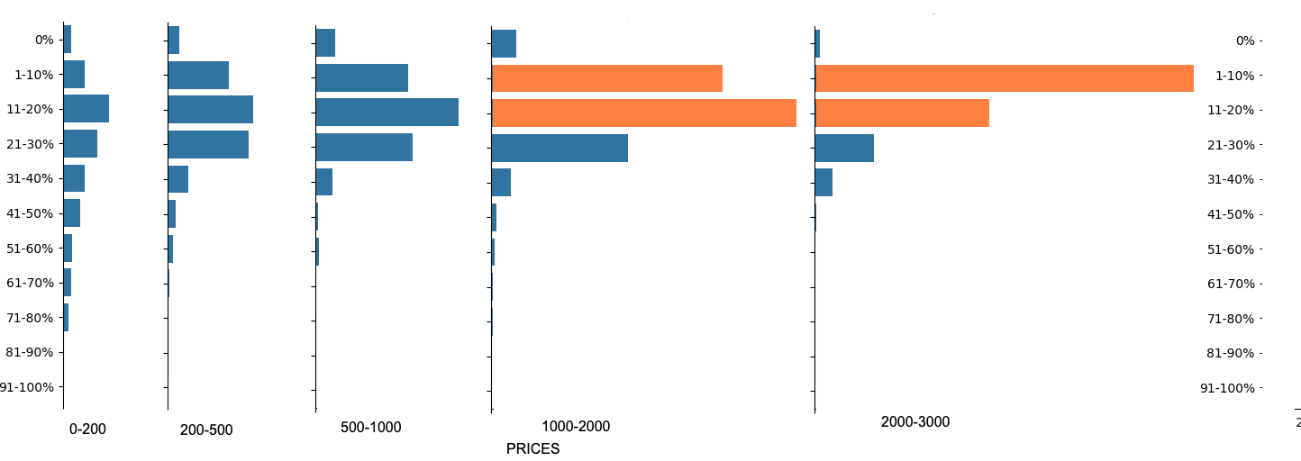
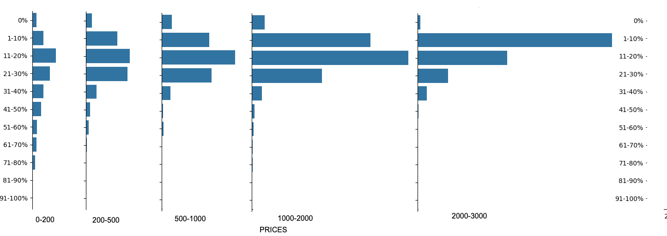
Revenue
Around 50% of
the revenue
< 3%

Slide 7
BRAND CATEGORIES
Data Analysis

Slide 8
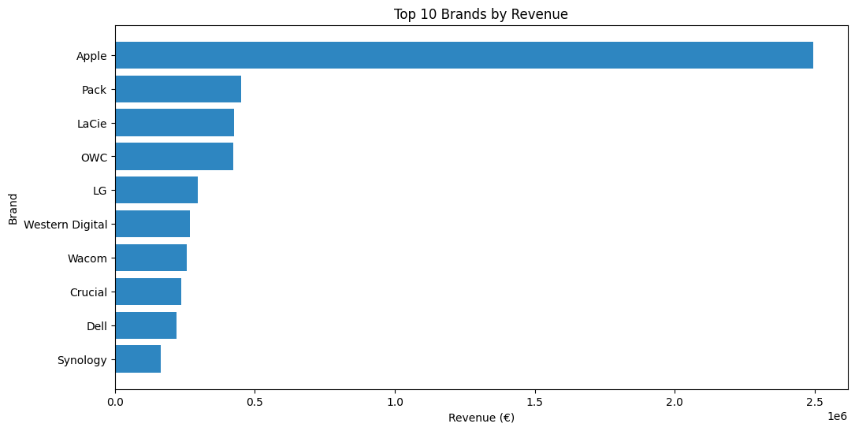
Apple’s Strong Brand Perception
High revenue generating products

Slide 9
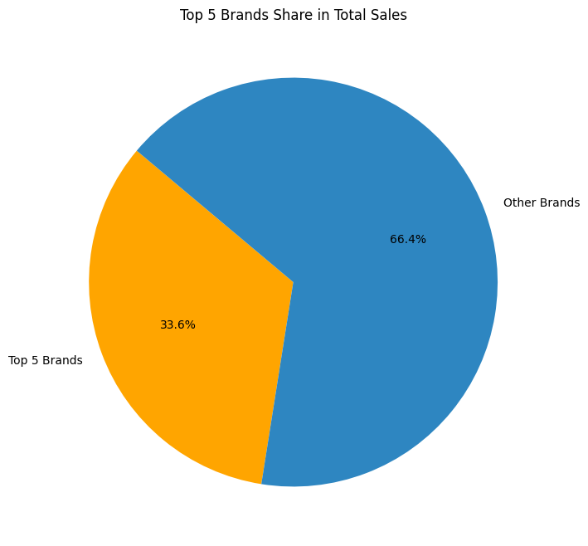
Sales Share of Top 5 Brands:
Apple, OWC, Pack, Western Digital, and Lacie account for nearly 34% of sales

Slide 10
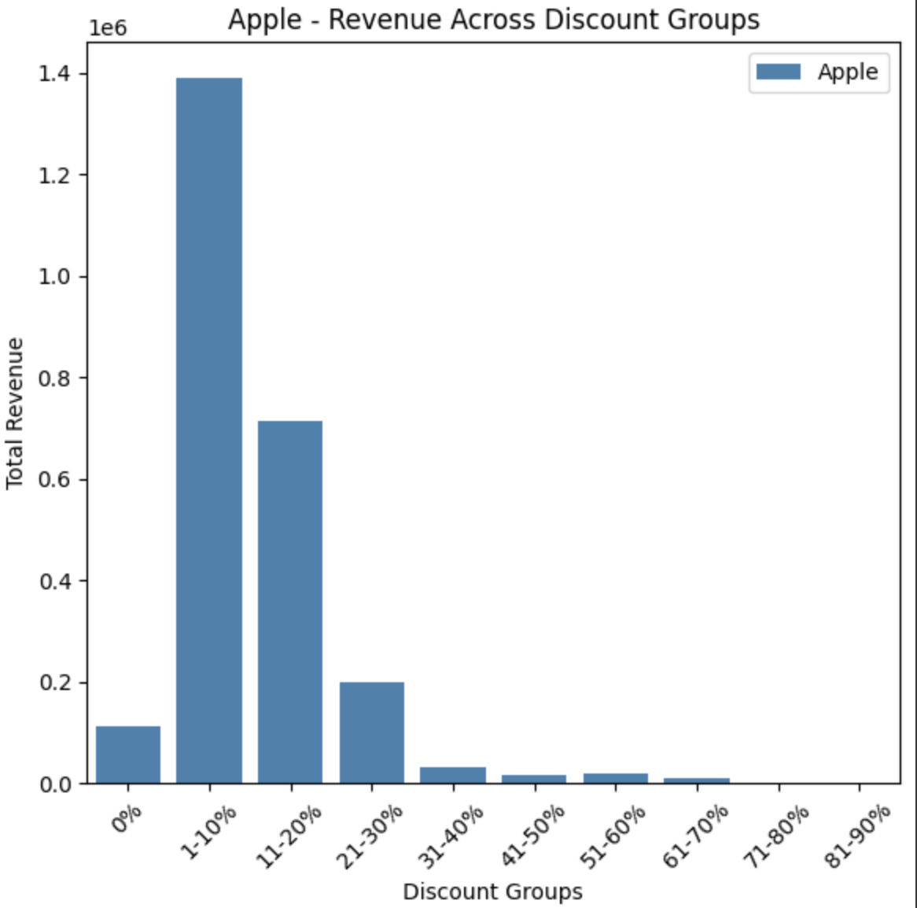
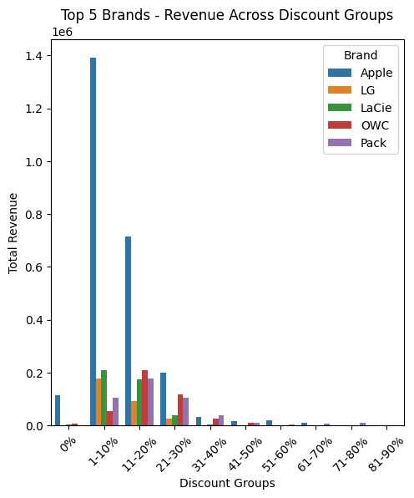
Revenue across discount groups

Slide 11
Seasonal Categories
SPRING
December
June
Black Friday, Christmas, Cyber Monday
FALL
WINTER
SUMMER
March
SEPTEMBER

Slide 12
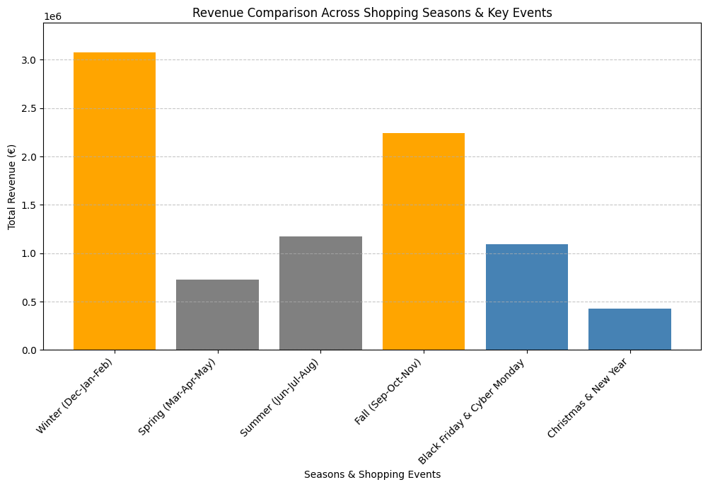
Revenue vs Shopping Seasons
Shopping seasons sales go high!

Slide 13
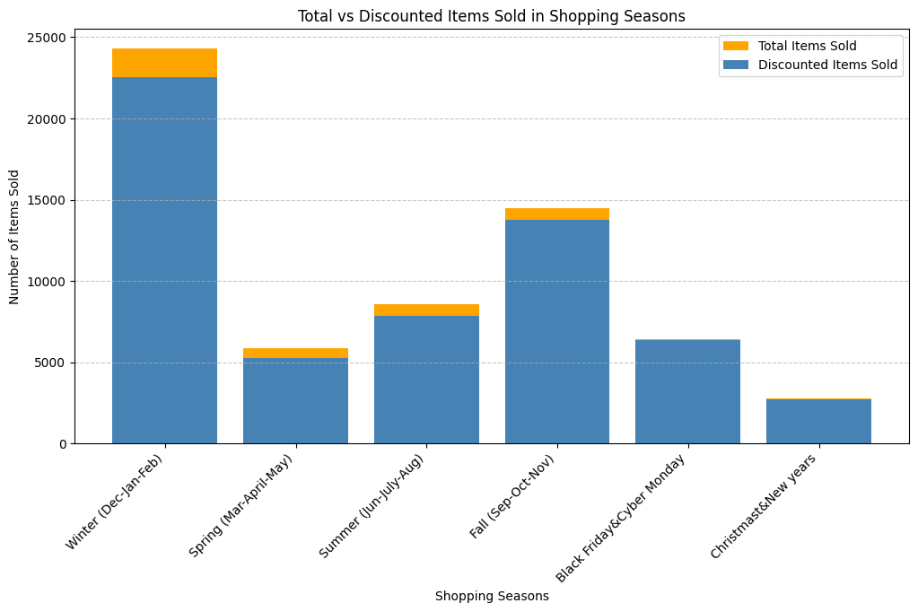
Discounted items sell every season

Slide 14

Recommendations:
Focus on small discounts (upto 30%)
Avoid high discounts on premium products
Consider shifting away from lower-priced items to prioritize higher-value offerings
Keep discounts for high-value products (upto 30%)
No aggressive discounts needed

Slide 15
High sales
Strategic discounts
Selective discounts
Profitability
Loyalty and competitiveness

Slide 16
THANK YOU

